Slide 1
011 Assignment
Task 2

Slide 2
What is Project?

Slide 3
What is a Project?
Characteristics
Temporary
Unique
Progressive Elaboration

Slide 4
Main Project characteristics (Maylor, 2017, pp. 7)
Exact project not been done before
Many aspects of the project have been done before
Impacts people delivering
Impacts people and organisations being delivered to
Detailed requirements may not be known in advance
Project manager has to deal with uncertainty
Delivers benefits
Aspects of uniqueness
Change
Emergence and uncertainty
Mission focused
Project Characteristics
Social construction
Temporary
Integrating
Doesn’t behave like a machine
Involves people and organisations
Team finishes when project finishes
Funding goes with project
Requires interlinking of activities
Requires knowledge and resources to be brought together in a process

Slide 5
Axelos PRINCE 2
Methodology

Slide 6
PRINCE 2
PRojects IN Controlled Environments
UK Gov standard
PRINCE – 1989 PRINCE 2 – 1996:
Focus on business justification
Defined organization structure for the project management team
Product-based planning approach
Emphasis on dividing the project into manageable and controllable stages
Flexibility that can be applied at a level appropriate to the project.

Slide 7
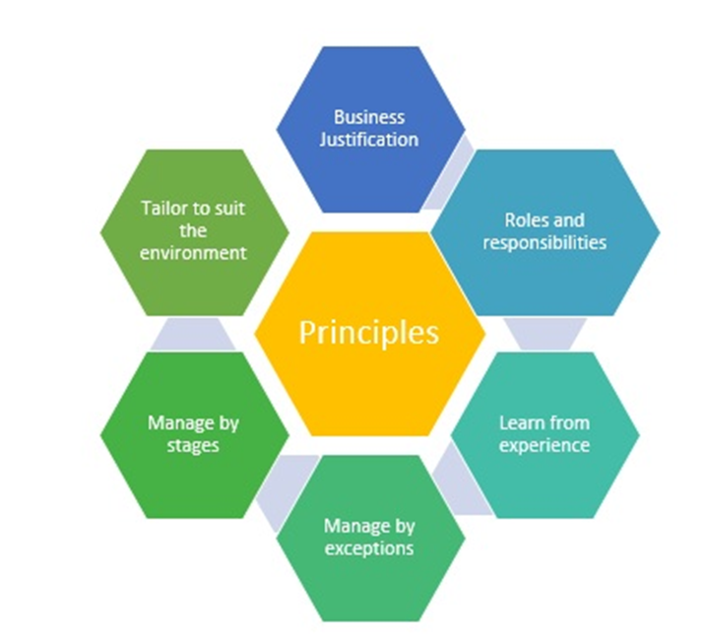
PRINCE 2 Principles
The principles provide a framework of good practice for those people involved in a project
Ensuring that the method is not applied in an overly prescriptive way
But applied in a way sufficient to contribute to the success of the project
So what are these principles?

Slide 8
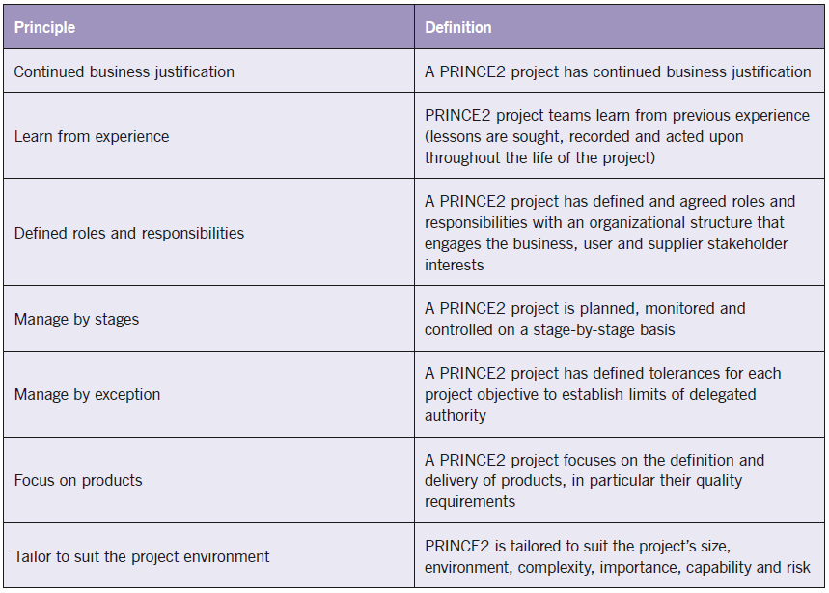
PRINCE 2 Principles
Murray (2011)

Slide 9
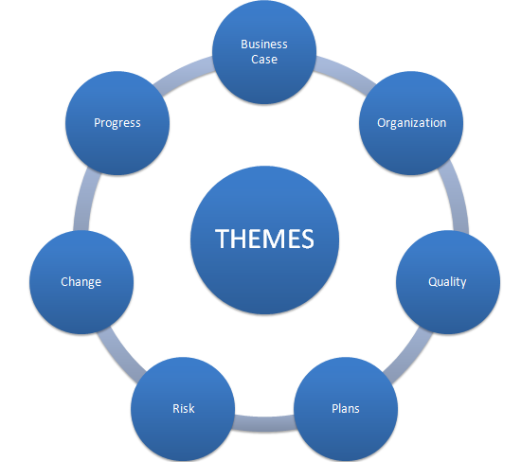
PRINCE 2 Themes
The PRINCE2 themes are those aspects of project management that need to be addressed continually throughout the project lifecycle
They provide guidance on how the process should be performed.

Slide 10
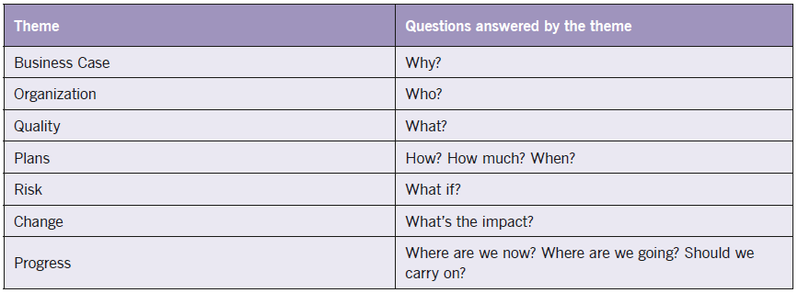
PRINCE 2 Themes

Slide 11
Prince 2 - 7 Processes
PRINCE2 provides a process model for managing a project.
This consists of a set of activities that are required to:
Direct
Manage and
Deliver a project.
An organised and controlled start, i.e. organise and plan before leaping in.
An organised and controlled middle, i.e. keeping projects organised and controlled.
An organised and controlled end, i.e. when you've got what you want and the project has finished, tidy up the loose ends

Slide 12
Prince 2 - 7 Processes
Starting up a project
Directing a project
Initiating a project
Controlling a stage
Managing product delivery
Managing a stage boundary
Closing a project
Pre-project
Initiation stage
Subsequent delivery stage(s)
Final delivery stage
Directing
Managing
Delivering
Directing a Project
Starting up a Project
SB
SB
Closing a Project
Initiating a Project
Controlling a Stage
Controlling a Stage
Managing Product Delivery
Managing Product Delivery
Axelos’s (2017)
SB = Managing a Stage Boundary
Notes:
Royce’s original stages: System requirements, Software Requirements, Analysis, Program Design, Coding, Testing, Operations

Slide 13
Starting up a Project: Covers the pre-project activities required to commission the project ‘Do we have a viable and worthwhile project?’
Directing a Project: Describes the Project Board’s activities in exercising overall project control.
Initiating a Project: Describes the activities the Project Manager must lead in order to establish the project on a sound foundation

Slide 14
Managing a Stage Boundary: Describes the activities the Project Manager must undertake to provide the Project Board with sufficient information to enable it to review the success of the current stage, approve the next Stage Plan
Controlling a Stage: Describes how the Project Manager manages the project execution/delivery activity during a stage, and reports progress and exceptions to the Project Board

Slide 15
Managing Product Delivery: Addresses the Team Manager’s role in supervising the detailed work of creating the project’s products
Closing a Project: Describes the closure activity towards the end of the final stage of the project

Slide 16
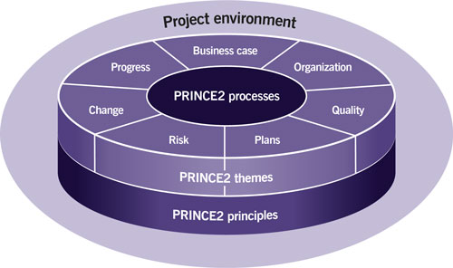
PRINCE 2- summary
Axelos - What is PRINCE2®?

Slide 17
Stakeholder Management

Slide 18
Stakeholder Defined
A Stakeholder is any individual, group or organization :
that shares a stake in the project
that can influence or be influenced by the project.
who have an interest in the project process or outcome
whose interest may be positively or negatively affected as a result of the execution and outcome
who are actively involved in the project

Slide 19
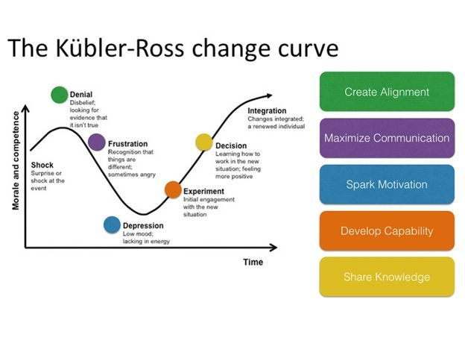
Objective of Stakeholder Mgt
To curtail stakeholder activities that might adversely affect the project
To integrate stakeholder perspective into the project’s formulation process
To facilitate the project team’s ability to take advantage of opportunities
To encourage stakeholder support for project purposes
Adapted From Kubler Ross (1969)
https://www.ekrfoundation.org/5-stages-of-grief/change-curve/

Slide 20
Stakeholder Management Process
Identification of Stakeholders
Stakeholder Analysis:
Determine their requirements and influence
Predict their behaviour (gaze into a crystal ball)
Develop appropriate Strategies
Manage and influence those requirements and perspectives by implementing the strategy

Slide 21
Categorization of Stakeholders
Internal Stakeholders
Responsible for the project's delivery
Usually play a supportive role
Project Manager has some degree of authority and influence
Should be kept well informed about project’s status
External Stakeholders
May not be supportive but rather adverse
Not usually subject to the legal authority of the project manager
Information should be provided on a
“need-to-know’” basis
But keep communication channels open

Slide 22
Internal Stakeholders Project Team (adapted from Maylor, 2017, pp. 62)
PROGRAMME MANAGEMENT
 | PROJECT BOARD/PROJECT STEERING GROUP
USER REPRESENTATIVE | PROJECT SPONSOR | SUPPLIER REPRESENTATIVE
Senior User | Executive/Senior responsible Owner | Senior Supplier
TECHNICAL ADVISORY GROUP
CHANGE BOARD Delegated authority Technical capability
PROJECT MANAGER
PROJECT MANAGEMENT OFFICE Admin support Technical support Configuration management
TEAM MANAGER
TEAM MANAGER
TEAM MEMBERS
TEAM MEMBERS

Slide 23
Stakeholder Analysis
For all potential project stakeholders identify relevant information, such as their roles, departments, interests, knowledge, expectations, and influence levels.
Analyze the potential impact or support each stakeholder could generate, and classify them so as to define an approach strategy.
Assess how key stakeholders are likely to react or respond in various situations, in order to plan how to influence them to enhance their support and mitigate potential negative impacts.

Slide 24
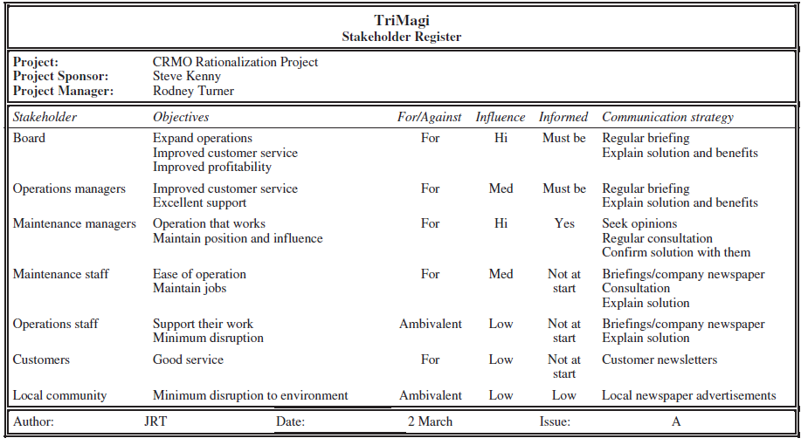
Use a Stakeholder Register
Turner (1999)

Slide 25


Power/Interest Grid
Stakeholders
Key Player and Manage expectations
Highest priority for the project manager
Manage actively through active engagement
Keep satisfied
Moderate priority group
Need to keep this group sufficiently involved
High
Power
Stakeholder mapping
Monitor only
Lowest level for the project manager
Don’t overload them with communication
Keep informed
Moderate priority group
Objective is to sustain their interest and leverage when useful to the project
Low
Low
Interest
High

Slide 26
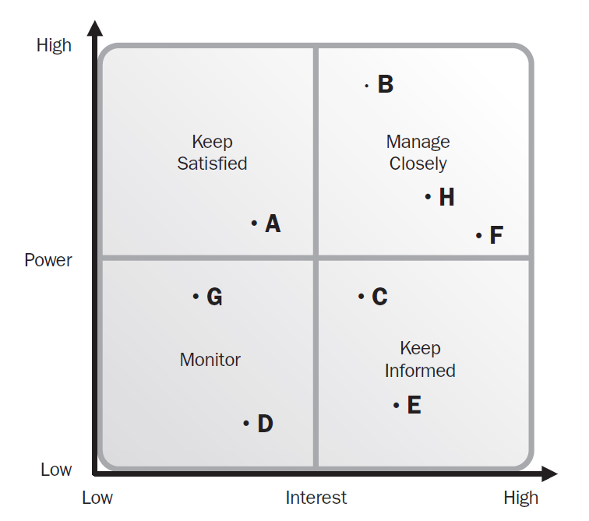
Plotting the Power/Interest Matrix with Stakeholders
A-H representing the placement of generic
stakeholders
PMI (2013)

Slide 27
Engaging Stakeholders
The process of developing appropriate management strategies to effectively engage stakeholders throughout the project life cycle
The key benefit of this process is that it provides a clear, actionable plan to interact with project stakeholders to support the project’s interests

Slide 28
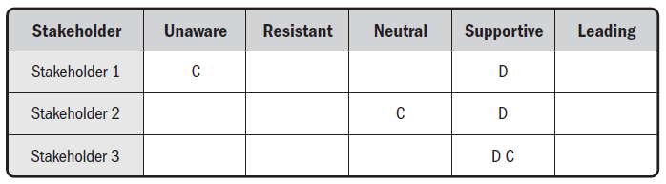
Stakeholders Engagement Assessment Matrix
C- indicates the current engagement
D- indicates the desired engagement

Slide 29
Risk Management

Slide 30
Fundamentals!
Everything we do carries risk
Project which break new ground attract many risks
Project risks can be predictable or completely unforeseeable

Slide 31
Risks can occur at any stage in a project
For very large projects it is necessary to appoint a Risk Manager, who develops and monitors a comprehensive Risk Strategy
Project Management Office is a logical place for the risk management function to reside

Slide 32
Importance of Risk Management
Potential effects range from trivial inconvenience to project disaster
A risk event that occurs late in a project can be more costly than a similar event nearer the start of the project

Slide 33
Simply because as time passes there will be a greater value of work in progress and higher sunk costs at risk of loss or damage
We read in the newspaper about cost overruns and schedule slips on a wide variety of large scale development projects. Is it because of RISKS?

Slide 34
Project Risk and Issues Management: Overview
Risks can be identified at any time on the project
Risk management is a continual process of identifying, assessing, planning responses and implementing responses.
Risks are often assessed using impact and probability (likelihood) – the higher the impact and probability the more important the risk.
Issues are risks that have occurred. Sometimes they were predicted through risk management, sometimes not.
Issue management needs to be in place to log the issue and how it was managed.

Slide 35
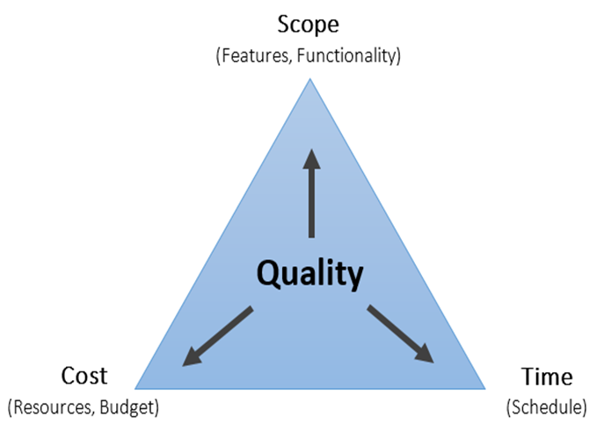
What is a Risk?
Project Risk is an uncertain event or condition
If it occurs, has a positive or negative effect
On one or more project objectives:

Slide 36
Risk Management on projects
All projects face risks of some nature
Risk "An uncertain event or condition that, if occurs, has a positive or negative effect on one or more project objectives.“ (PMI, 2021, p. 53, 117, 122 and 248)
Reminder – a risk can be positive, e.g. price reduction in the future on a project resource
Managing those risks in a professional manner is a key part of project management
Risk Appetite ”the degree of uncertainty an organisation or individual is willing to accept in anticipation of a reward" (PMI, 2021, p. 54 and 248)
Find a balance between being too risk averse and avoiding acceptable risks …
… but not being unnecessarily reckless and ignoring real risks that could jeopardise the success of the project

Slide 37
Risk Management Process
From beginning
Continual monitoring
Plan Risk Management
Implement Responses
Identify
Categories of risk and potential risks and document (register/log and RBS)
When/if risk becomes an issue
Formulate a response, document it
Response
Plans
Analyse Risks:
Quantitative Qualitative
Potential consequences, likelihood
Matrix commonly used

Slide 38
Risk identification
Risk identification should start as early as possible during the initial project phases and should be an ongoing part of planning activities.
One of the main objectives at this stage is to not only identify the risk but also capture the information available about the risk itself and wherever possible assess the likely impact the risk might have on the project.
Collect Risks through:
Brainstorming with project team and experts – use Risk Breakdown Structure categories to guide the discussion
Checklists - from past similar project, be sure to consider more areas
Interviews – with project participants, stakeholders and subject matter experts
Results in a “Risk Register or Log” and/or Risk Breakdown Structure

Slide 39
The risk register/log
This project document must be updated with any new risks as and when they are identified. The risk log provides a key point of control during the lifetime of the project.
Risk ID | Description | Date Raised | Author | Owner | Probability | Impact | Proximity | Response | Status | Date Closed

Slide 40
Qualitative Risk Analysis Risk impact Matrix
The closer a risk gets to this corner, the more important it becomes
Probability
Impact

Slide 41
Threat Strategies (PMI, 2021, p.123)
STRATEGY | DEFINITION
ESCALATE: | Escalation is appropriate when the project team or project sponsor agrees that a threat is outside the scope of the project or that the proposed response would exceed the project manager's authority.
AVOID: | When the project team acts to eliminate the threat or protect the project from its impact.
TRANSFER: | Transfer involves shifting ownership of a threat to a third party to manage the risk and to bear the impact if the threat occurs.
MITIGATE: | Action is taken to reduce the probability of occurrence and/or the impact of a threat. Early mitigation is usually more effective.
ACCEPT: | Acknowledge the existence of a threat, but no proactive action is taken.
Notes:
Escalate - Escalate to program level, portfolio level or other relevant part of the organisation.
Change the project plan or objectives, isolate the project objectives fro risk's impact, e.g. extend schedule, change strategy, reduce scope.
Responses to managing risks can generally be categorised as follows:
Tolerate – accept the risk without any immediate action
Treat – implement actions to reduce the impact and/or probability of risk occuring
Terminate – completely cease any project activities that could result in the risk
Transfer – transfer the risk to another party e.g. insurance policies, contractors
Take the risk – implies a positive risk where the rewards are considered to be worth the risk
Terminology
Contingency – Is the planned allotment of time and cost or other resources for unforeseeable risks within a project.
Contingency Plan – Alternative course(s) of action to cope with project risks or if expected results fail to materialise.
The selected response to a risk and whether contingency is needed will depend on a number of factors.

Slide 42
Project Charter

Slide 43


Purpose of the Project Charter
Stewardship & Governance
Bring together Project Start Up into one document for project governance
Formal/informal
its background
the reasons why it is being carried out
the choice of options available for the project approach and outcome (it is important to include a ‘do nothing’ option to aid effective decision making)
the planned benefits the known risks
costs
the timescales envisaged
Owned by Project sponsor – Maintained by Project Manager

Slide 44



End Result: Project Charter (from PMI, 2017) also called a Project Initiation Document (PID)
Monitoring &
Controlling Processes
Integrated Planning
Project Start Up
Project Close
Managing Deployment
Contents of a Project Charter:
Project Purpose
Measurable project objectives and related success criteria
High-level requirements
High-level project description, boundaries and key deliverables
Overall project risk
Summary milestone schedule
Preapproved financial resources
Key stakeholder list
Project approval requirements (what constitutes success, who decides the project is successful, who signs off o the project
Project exit criteria (i.e.. What are the conditions to be met In order to close or to cancel the project or phase)
Assigned project management, responsibility, and authority level
Name and authority of the sponsor or other person(s) authorising the project charter
What?
Purpose, objectives, requirements
Risks
Timing and Resources
Stakeholders
Approval and authority

Slide 45
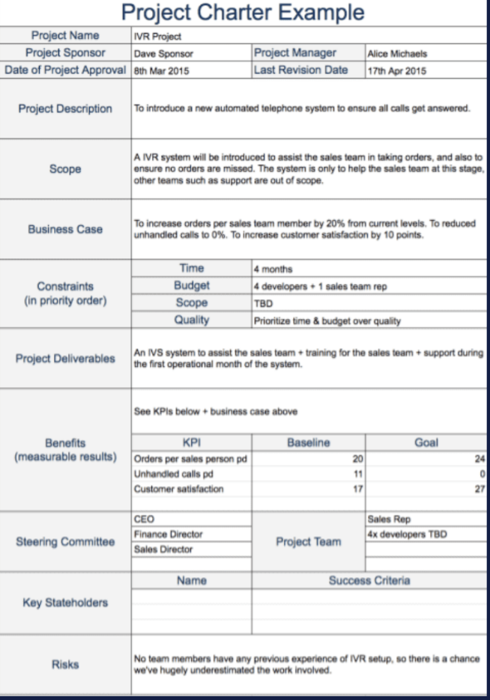
Example
Monitoring &
Controlling Processes
Integrated Planning
Project Start Up
Project Close
Managing Deployment
Different companies will have their own format for the document for you to follow

Slide 46
Example Project Charter (or PID), Restaurant example
Project Name | Delicious and Healthy
Project Sponsor | C. Rich
Date of Project Approval | 15 Jan
Project Description | To launch a new restaurant with a “Delicious and Healthy” theme, where customers feel they can go to relax and enjoy the food. Create a dining experience that takes away concerns about calorie intake, fat, excess sugar, salt, etc.
Scope and boundaries | “Delicious and Healthy” restaurant will need to be designed and implemented in terms of: menu; logo and branding and restaurant layout and feel. The customer service experience is out of scope as “Delicious and Healthy” customer service approach will mirror the parent company’s already defined processes. The recruitment of staff for the restaurant is outside of the project scope as this will be managed by the parent company. The kitchen layout and functionality is out of scope as this will be managed by the parent company.
Business Case | To diversify the parent company’s restaurant offering and increase sales, with a target of gaining return on investment in 2 years. To tap into a segment of the market that wants to have healthy options on the menu, but take this further to innovate and create nutrition and taste themed experience. Recent surveys indicate that 71% of diners say health should not be disregarded (Hospitality and Catering News, 2020) and that 68% try to eat healthy all or most of the time (Mintel, 2021)
Project Manager | Helen Benton
Last Revision Date | 15 Jan
Notes:
https://www.hospitalityandcateringnews.com/2020/01/new-restaurant-report-what-uk-consumers-want-from-eating-out/

Slide 47
Objectives and Deliverables
Project Objectives | Design a restaurant interior that conveys comfort and health by 18 June in line with a budget of £820,000 Purchase all required restaurant fixtures and fittings to begin construction and installation on 18 June, with a total budget of £1,270,000 Liase with parent group on kitchen installation and recruitment/training with a completion date of 30 July. Oversee the installation of the restaurant to a high standard with a completion date of 30 July. Conduct market research into the tastes and customer preferences in the area by 11 June. Develop recipes that are delicious and designed with good nutrition using the recommended daily nutritional values by 2 July Establish supplier relationships with key suppliers by 16 July Test recipes with customers and consider feedback by 23 July Final menu confirmed by 30 July Develop marketing assets: logo, branding, tagline and visuals by 2 July Prepare and market launch event by 9 July Launch restaurant on 6th August
Project Deliverables and milestones | Restaurant facility ready for launch in August with a healthy and comfortable layout and feel ready for 30 July Menu designed and tested, ready for 30 July Supply chain and key relationships established ready for 30 JUly Marketing assets developed by July Launch event organised for August

Slide 48
People, Stakeholders and Risks
Steering Committee | CEO Group Hospitality Director Group HR Director
Key Stakeholders | Project Sponsor: C Rich Project Team Contractors Consultants Existing restaurant franchises in the group
Key Risks | Procurement delays impacting the installation schedule Difficulties finding suppliers for key products Unable to develop food that is both healthy and delicious Customers do not like the menu etc
Project Team | Interior Designing Consultant Marketing Consultant Marketing intern Procurement Administrator Project Administrator Building contractor Electrical contractor Heating contractor
Competitors
Health and safety
Food standards agency
Local council
Customers

